Slide 1
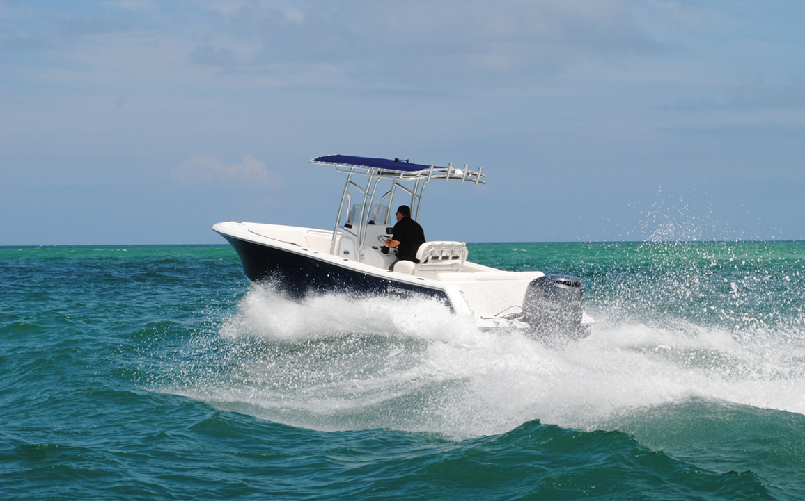
Boat Insurance Basics: 5 Insider Secrets to the Best & Cheapest
Boat Insurance

Slide 2
Agreed Value vs Book Value
If there’s a claim, how will they value your boat?
www.BoatBuyersSecretWeapon.com

Slide 3
Parts & Labor Rates
If there’s a claim, how much will they pay to shop to fix it?
Who choose the shop?
www.BoatBuyersSecretWeapon.com

Slide 4
Salvage Coverage
If your boat sinks, who will pay to clean it up?
www.BoatBuyersSecretWeapon.com

Slide 5
Towing Reimbursement
If you need a tow, how much if any will they cover?
www.BoatBuyersSecretWeapon.com

Slide 6
Speed of Approval
If there is a claim, how quickly will they approve your claim so you can get back out on the water?
www.BoatBuyersSecretWeapon.com

Slide 7
How to Get the Cheapest Insurance
Homeowners Provider
Marine Insurance Provider
(that specializes in your type of boat)
www.BoatBuyersSecretWeapon.com

Slide 8
Get a Multiple Quote for BEST & Cheapest Coverage
Homeowners Provider
Marine Insurance Provider
www.BoatBuyersSecretWeapon.com

Slide 9
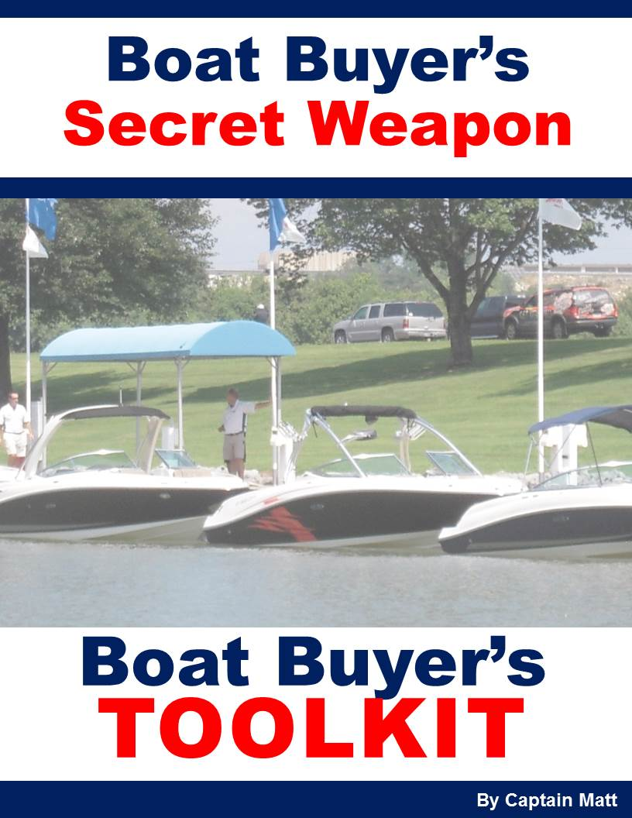
Claim Yours for FREE NOW!
www.BoatBuyersSecretWeapon.com

